Slide 1


Singapore Resuscitation and First Aid Council
2nd SRFAC Town Hall Session
25th May 2019, 0930hrs
SGH Academia

Slide 2
Singapore Resuscitation and First Aid Council
Time | Description
9am - 9.30am | Registration
9.30am - 9.35am | Welcome Address by Prof Lim Swee Han, SRFAC Chairman
9.35am – 10.05am | “Singapore Out-of-Hospital Cardiac Arrest Registry Report (2011 – 2016)” by Prof Marcus Ong, Medical Director for Unit for Prehospital Emergency Care (UPEC)
10.05am – 10.35am | “To Save, or Not To Save: Identifying motivations and inhibitions behind community response in times of emergencies” by Mr Eu Juan Lih, Behavioural Sciences Research Analyst, Ministry of Home Affairs
10.35am – 11.20am | Sharing by SRFAC - Admin and Operations by Daniel - Resuscitation and First Aid Guidelines by Jun Hao
11.20am – 12pm | Question and Answer
12pm – 1pm | Lunch and Farewell

Slide 3
Singapore Resuscitation and First Aid Council
Welcome Address by SRFAC Chairman
Prof Lim Swee Han

Slide 4
Singapore Resuscitation and First Aid Council
“Singapore Out-of-Hospital Cardiac Arrest Registry Report (2011 – 2016)”
by Prof Marcus Ong,
Medical Director for Unit for Pre-Hospital Emergency Care (UPEC)

Slide 5
Singapore Resuscitation and First Aid Council
Q & A
and
Presentation of token of appreciation

Slide 6
Singapore Resuscitation and First Aid Council
“To Save, or Not To Save: Identifying motivations and
inhibitions behind community response in times of emergencies”
by Mr Eu Juan Lih,
Behavioural Sciences Research Analyst, Ministry of Home Affairs

Slide 7
Singapore Resuscitation and First Aid Council
Q & A
and
Presentation of token of appreciation

Slide 8
Singapore Resuscitation and First Aid Council
Admin and Operations

Slide 9
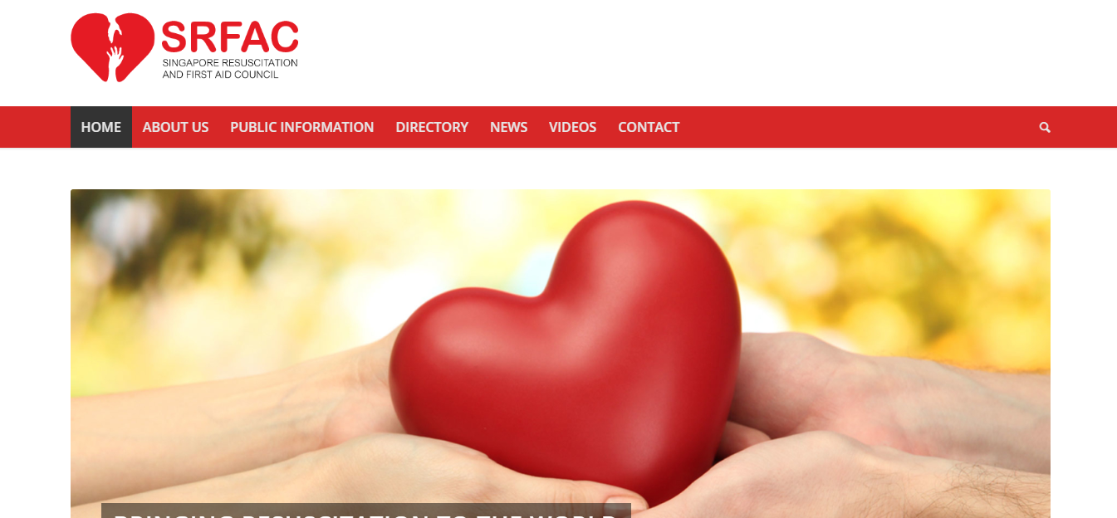
Launched in August 2018
Existing Training centres came on board in waves

Slide 10
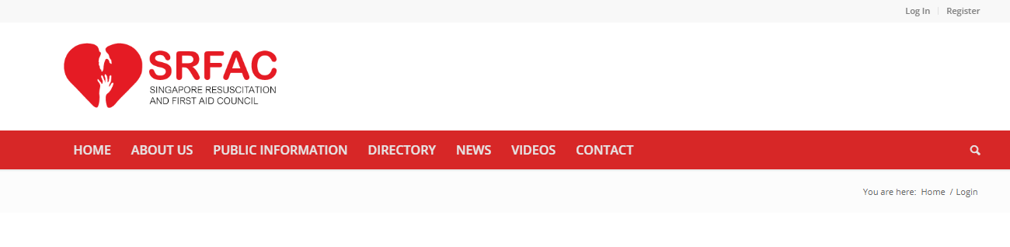
URL: www.srfac.sg
Can be accessed via laptop, mobile devices etc

Slide 11
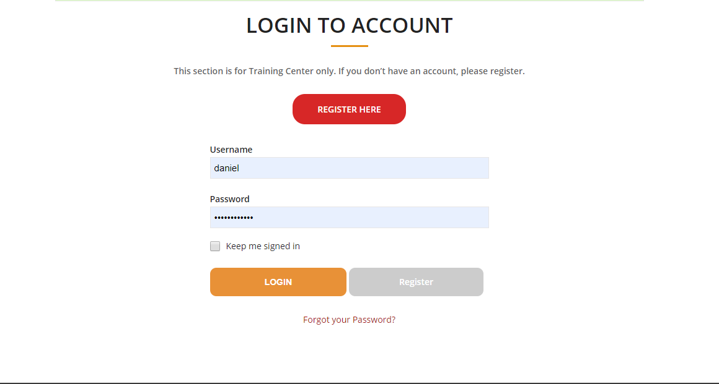
Login Page

Slide 12
When you forget your password

Slide 13
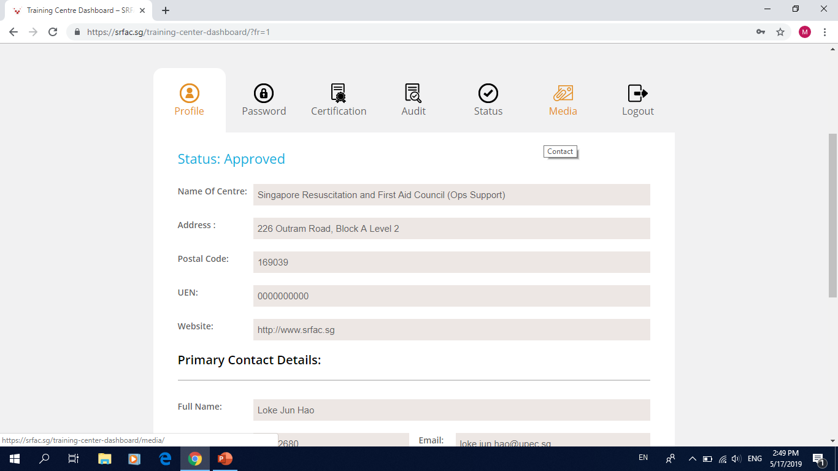
Profile: Allows you to key in important details about your company, and the contact for your primary and secondary representative
Password: Allows you to change your password/username
Certification: For new users. Allow you to indicate which certification your training centre already attained.
Audit: Allows you to submit audit online (BCLS+AED, CPR+AED, LSCN, ACLS, SFA, CFA etc)
Status: Check audit status
Media: can find additional resources likes Accreditation Guide, BCLS+AED manual, CPR+AED manual etc can be found

Slide 14
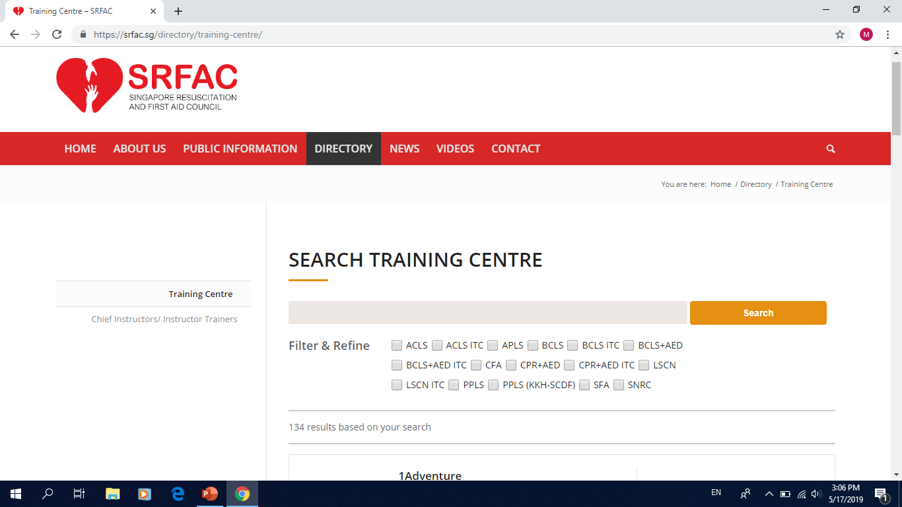
Searching for Training Centre

Slide 15
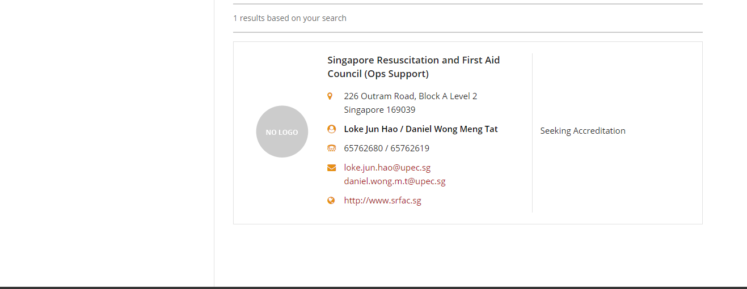
Search Result

Slide 16
Searching for Training Centre

Slide 17
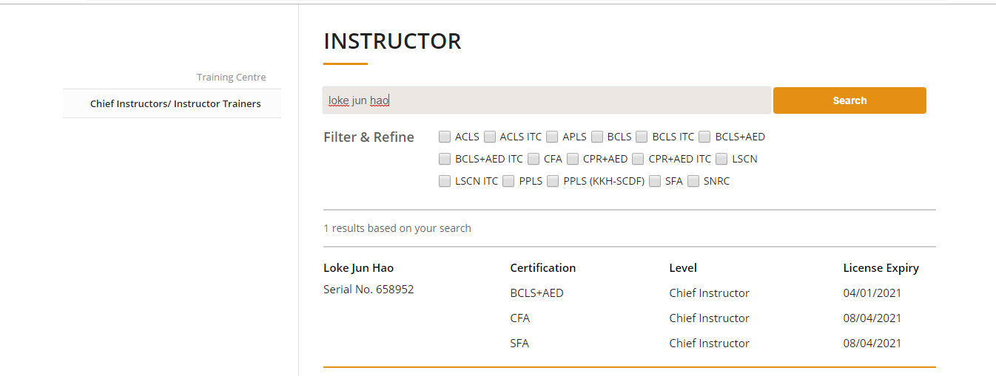
SRFAC only tracks the following: Chief Instructor Chief Instructor Trainer Instructor Trainer | For renewal or new appointment, please email Daniel with the relevant documents/evidence at daniel.wong.m.t@upec.sg

Slide 18
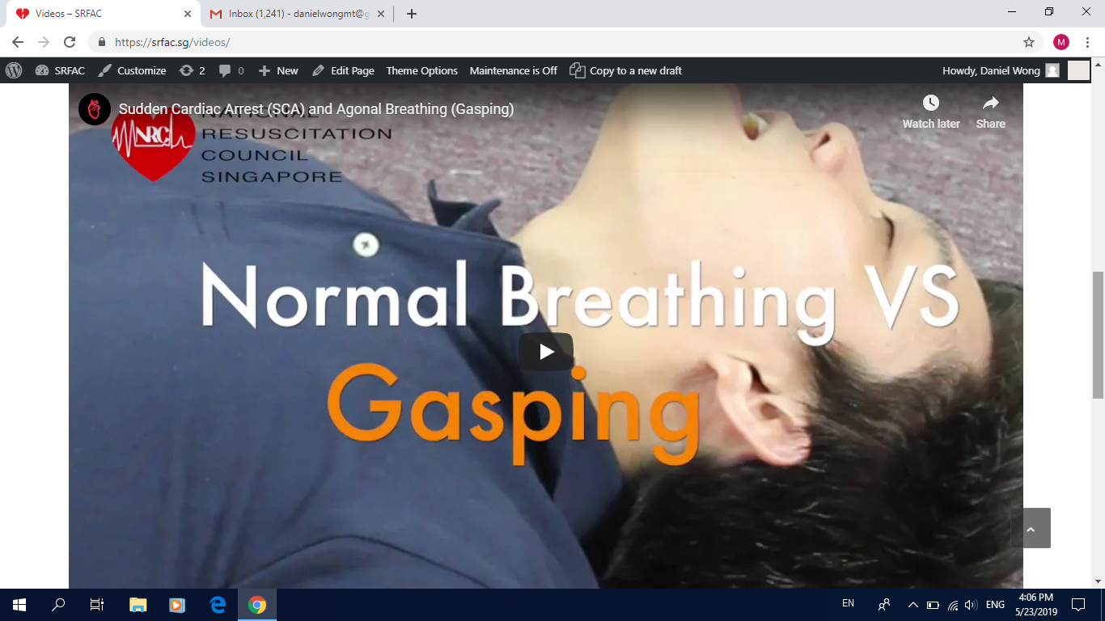
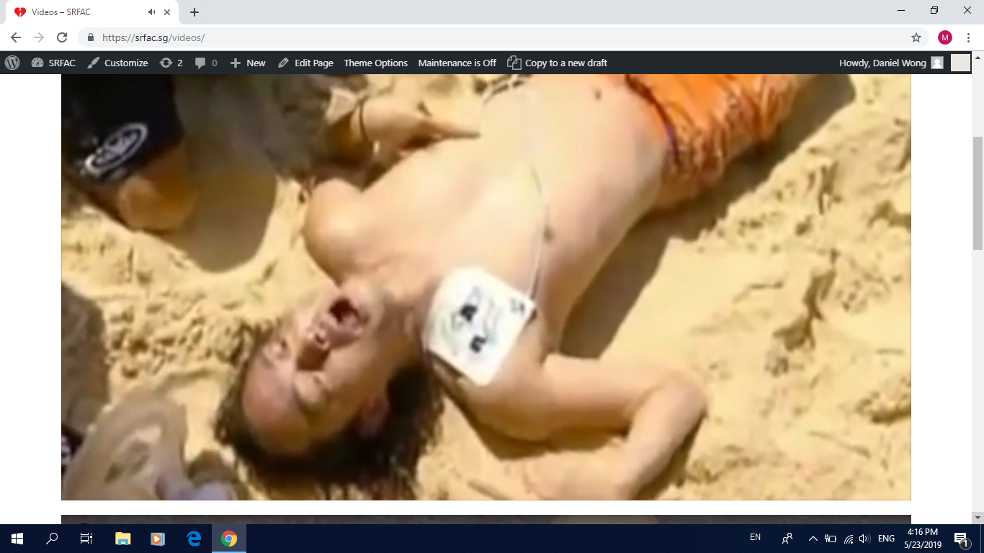
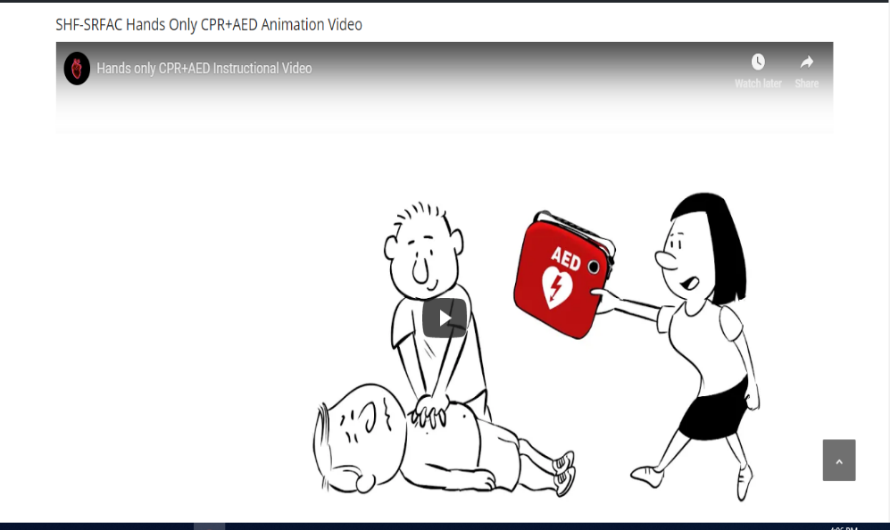
Gasping videos x 2
SHF-SRFAC Hands Only CPR+AED Animation Video

Slide 19
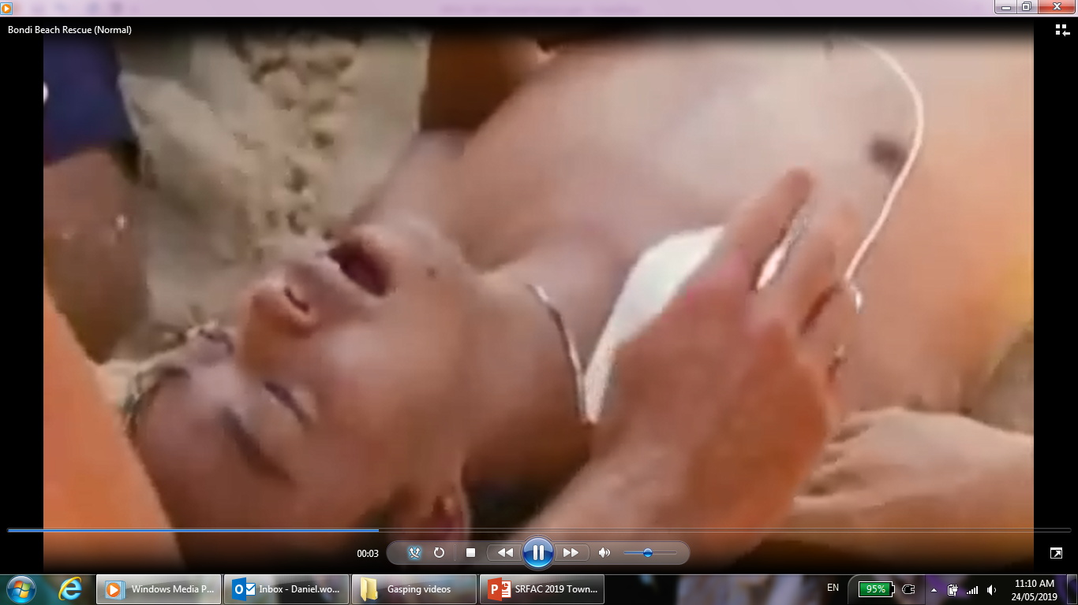
Example of Gasping/ Agonal Breathing
Example of Normal Breathing

Slide 20
Singapore Resuscitation and First Aid Council
SRFAC Chair: Prof Lim Swee Han, SGH
SRFAC Vice-Chair: A/Prof Ng Kee Chong, KKH
BCLS+AED Sub-Committee Chair: Prof Lim Swee Han, SGH
ACLS Sub-Committee Chair: A/Prof Ching Chi Keong, NHC
LSCN Sub-Committee Chair: Ms Wee Fong Chi, TTSH
LSCN Sub-Committee Co-Chair: Ms Jenny Chew, NYP
LSCN Sub-Committee Advisor: Dr Fong Wee Kim, TTSH
Paediatric Sub-Committee Chair: Dr Gene Ong, KKH
First Aid Sub-Committee Chair: MAJ Janice Oh, SCDF

Slide 21
Singapore Resuscitation and First Aid Council
World Restart a Heart Day, 16 October 2018
An article was published on SAF Facebook page and SRFAC website to celebrate World Restart a Heart Day (WRAH), with inputs and support from Singapore Armed Forces (SAF) and Ministry of Education (MOE).
Every year on 16th of October, all seven constituent councils of ILCOR support this global initiative. WRAH aims to increase awareness about the importance of bystander CPR and to also increase actual bystander CPR rates worldwide.
Partnered Singapore Heart Foundation (SHF) to commemorate World Heart Day (WHD) and World Restart a Heart Day (WRAH Day) on 29 September 2018
Launch of the Hands-Only CPR Kiosk during the event (CPR Kiosks are rotated around the island at different public spaces)
A SHF-SRFAC joint effort to produce an animation on Hands-Only CPR with AED (can be viewed on SRFAC website)

Slide 22
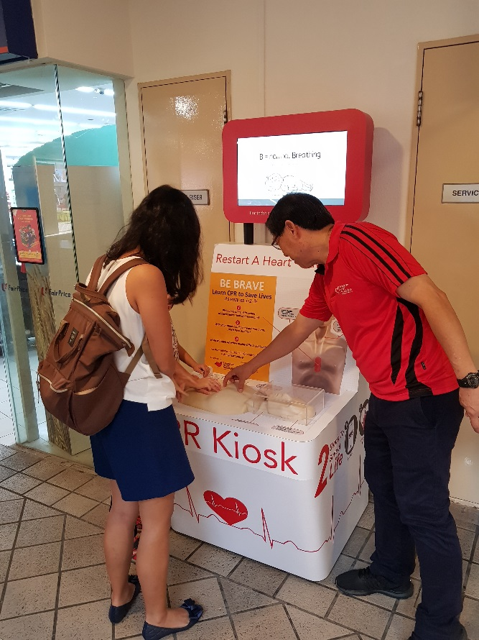
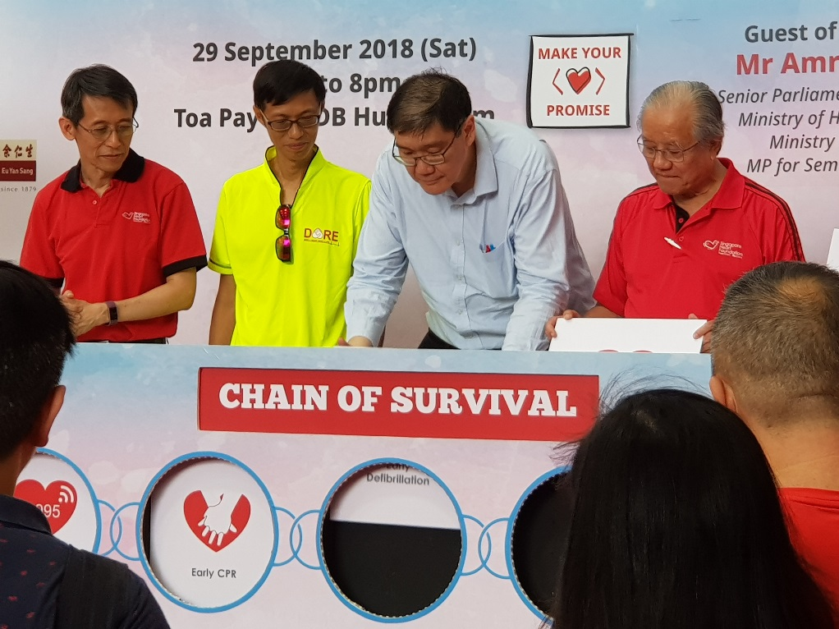
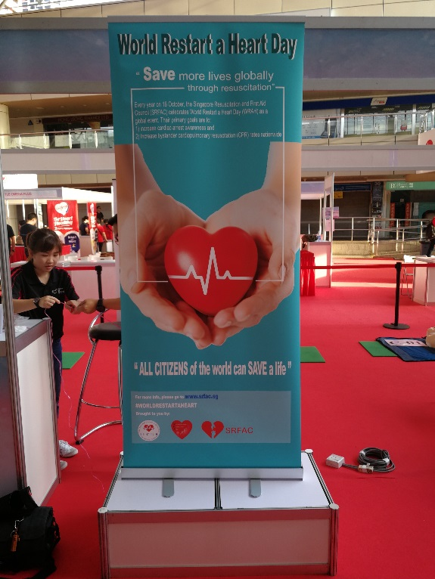
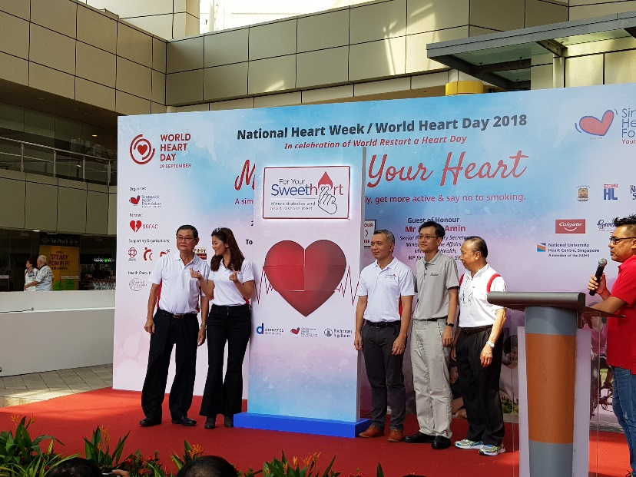

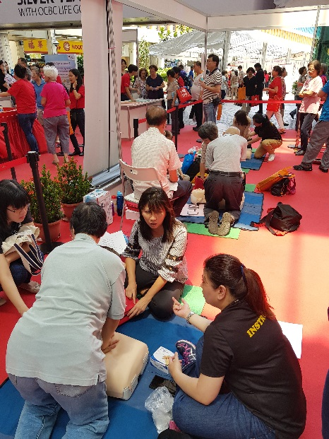
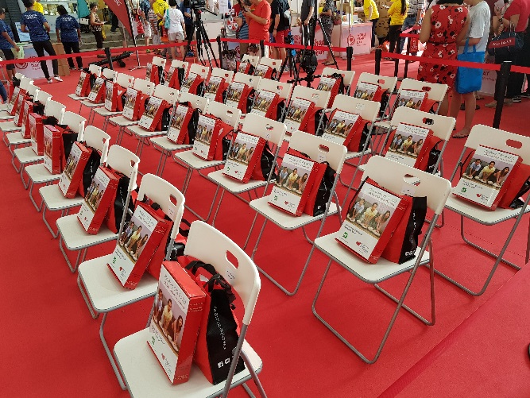
Singapore Resuscitation and First Aid Council

Slide 23
Singapore Resuscitation and First Aid Council
2019 Events Update
World Restart a Heart (WRAH) Day:
Event to be launched jointly with Singapore Heart Foundation’s (SHF) Project Heart and Unit for Prehospital Emergency Care’s (UPEC) Survivors’ Award
Date: 12 October 2019
Location: Singapore Expo Hall 8
Brief: To support ILCOR’s initiative to increase awareness about the importance of bystander CPR and to increase actual bystander CPR rates worldwide.

Slide 24
Singapore Resuscitation and First Aid Council
Resuscitation
and First Aid
Guidelines

Slide 25
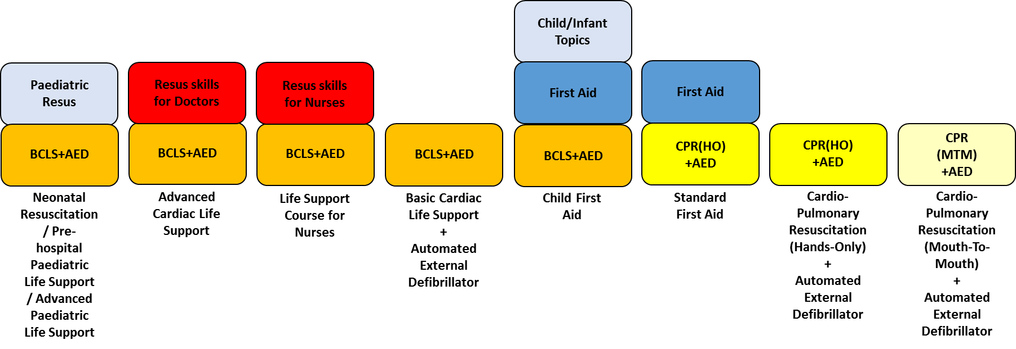
Singapore Resuscitation and First Aid Council
Courses under SRFAC Purview

Slide 26
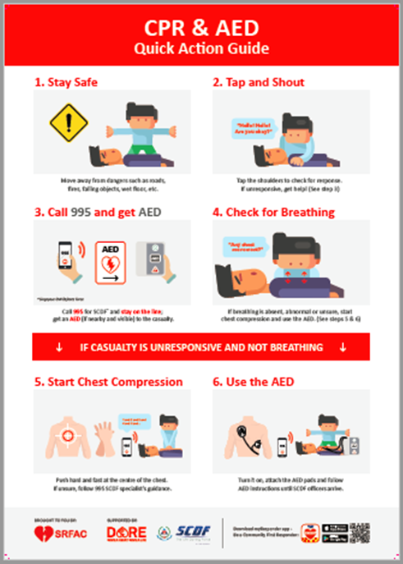
Singapore Resuscitation and First Aid Council
Merged BCLS with AED to form BCLS+AED program – complete implementation by 1st June 2019
Reviewed and revised Basic Life Support (BLS) documents – audit checklists, Training Centre guidelines, accreditation guide and instructor criteria
BCLS+AED and CPR(Hands-Only)+AED Manuals made available in PDF in August 2018
Requirement for evidence-based recording for all one-rescuer CPR performance by 1st June 2019
Created a CPR and AED Protocol reference document
New CPR and AED Quick Action Guide poster (to replace previous NRC poster) completed and released in April 2019
All provider certifications may enroll for re-certification/refresher course 3 months before or after the stated expiry date

Slide 27
Singapore Resuscitation and First Aid Council
Specific manikins are required to be used for all practical assessment of one rescuer CPR from 1st June 2019
For manikins intended for CPR(Mouth-To-Mouth), assessment recording must display the following:
Total elapsed time for 5 cycles
Total number of compressions
Total number of ventilations
Total number of correct and incorrect compressions
Insufficient recoil/relaxation of compressions
Correct Compression depth set at 4cm to 6cm
Correct ventilation volume set at 400ml to 600ml
Line/graph/strip of actual compressions and ventilations
For manikins intended for CPR(Hands-Only), assessment recording must display the following:
Automatic cut-off at 120 seconds
Total number of compressions
Total number of correct and incorrect compressions
Insufficient recoil/relaxation of compressions
Correct Compression depth set at 4cm to 6cm
Line/graph/strip of actual compressions

Slide 28
Singapore Resuscitation and First Aid Council
There is no list of “SRFAC-approved” products.
When purchasing the manikins intended for CPR(Mouth-To-Mouth) or CPR (Hands-Only) assessment recording, please refer to “SRFAC BCLS+AED and CPR+AED Manikin Specification” on the SRFAC website under public information:
https://srfac.sg/public-information/

Slide 29
Singapore Resuscitation and First Aid Council
Adult one-rescuer CPR | Mouth-To-Mouth | Hands-Only
Courses | BCLS+AED CPR(Mouth-To-Mouth)+AED Child First Aid | CPR(Hands-Only)+AED Standard First Aid
Criteria | 5 cycles of CPR to be completed within 130 seconds At least 150 chest compressions Up to 30 errors allowed: insufficient recoil incorrect depth improper hand position (within lower sternum but not on the Xiphoid Process or on the ribs) – must be visually verified by Instructor Immediate failure for wrong hand position (outside lower sternum, on Xiphoid Process or on the ribs) visibly outside body of sternum – must be visually verified by Instructor At least 5 ventilations above 400ml | Continuous compressions for 120 seconds (timing cut-off at 120 seconds) At least 180 chest compressions Up to 30 % errors allowed based on total number of compressions: insufficient recoil incorrect depth improper hand position (within lower sternum but not on the Xiphoid Process or on the ribs) – must be visually verified by Instructor Immediate failure for wrong hand position (outside lower sternum, on Xiphoid Process or on the ribs) visibly outside body of sternum – must be visually verified by Instructor If rest is needed, do not exceed 10 seconds (only for hands-only CPR phase without AED), preferable after 100 chest compressions.

Slide 30
Singapore Resuscitation and First Aid Council
Revised Standard First Aid (SFA) and Child First Aid (CFA) syllabus:
SFA course hours revised to 16 hours from 20 hours
SFA to incorporate Hands-Only CPR and AED
SFA learners will receive SFA and CPR(Hands-Only)+AED Provider certificates
Implementation of new SFA will start 1st June 2019.
CFA course revised to 23 hours from 24 hours and will include full elements of SFA and BCLS+AED
CFA learners will receive SFA, BCLS+AED and CFA Provider certificates
Implementation of new CFA will start 1st Aug 2019.
“SFA+AED” should be re-titled as “SFA”.
All provider certifications may enroll for re-certification/refresher course 3 months before or after the stated expiry date.

Slide 31
Singapore Resuscitation and First Aid Council
Introduction of First Aid Chief Instructor:
May function as an Instructor
Ensures the safety and well-being of Learners (Trainee-Providers) and Instructors
Supervise and mentor First Aid Instructors
Ensure Instructor’s adherence to training schedule and syllabus
Ensure that the course content is updated and in-line with SRFAC guidelines
Ensure that Learners (Trainee-Provider) are assessed fairly, address issues raised by Learners/Instructors and facilitate improvements to the course

Slide 32
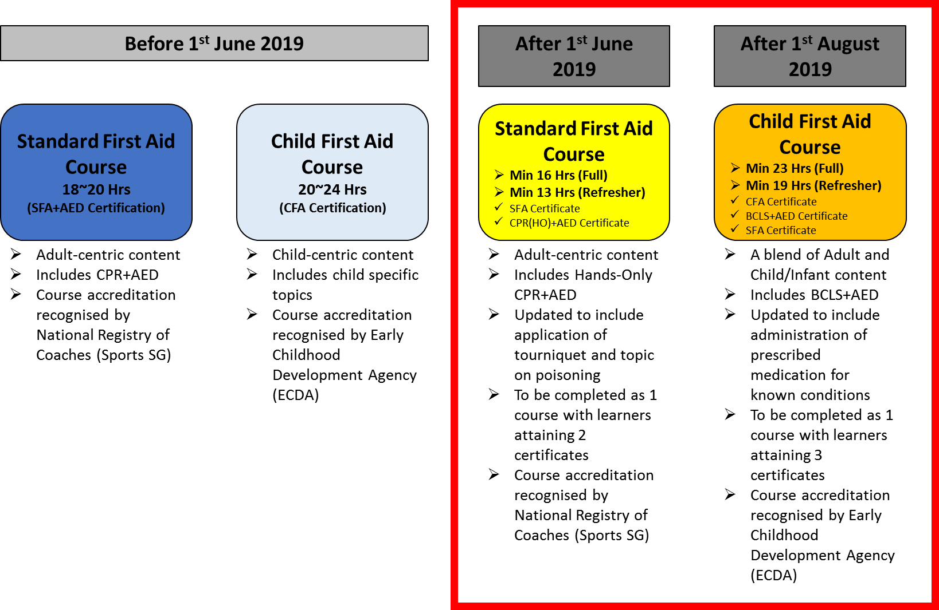
Singapore Resuscitation and First Aid Council

Slide 33
Singapore Resuscitation and First Aid Council
Coming soon…
Public-access AED analysis interval to be standardized at 2 minutes instead of the current 1 minute
Release of Standard First Aid (est. June 2019) and Child First Aid (est. July/August 2019) manuals
Creation of a national First Aid Instructor Program for Standard First Aid (SFA) and Child First Aid (CFA) Instructors
Auditor session – BLS and First Aid Auditors
Review of BLS Instructor Training Program (BCLS+AED and CPR+AED)

Slide 34
Singapore Resuscitation and First Aid Council
Question and Answer

Slide 35
Singapore Resuscitation and First Aid Council
Lunch and Farewell

Slide 36
Thank You!

